Slide 1
Contrasting patterns of taxonomic and phylogenetic homogenization associated with with introduced species spread in plant communities of the conterminous United States Relatedness among non-native plant species drives phylogenetic homogenization even in the absence of taxonomic homogenization Relatedness among non-native plant species drives phylogenetic homogenization even as taxonomic homogenization varies with regional non-native richness

Slide 2

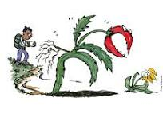
Invasive species impact biodiversity

Slide 3
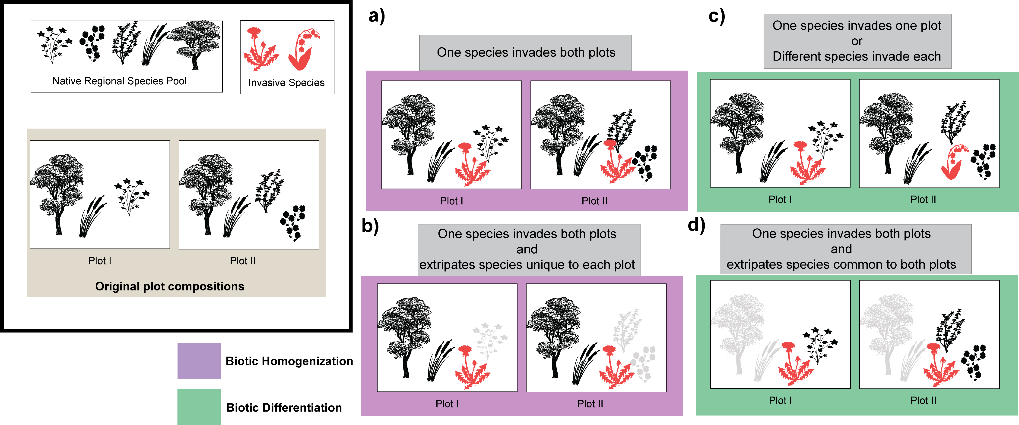
Biotic homogenization

Slide 5
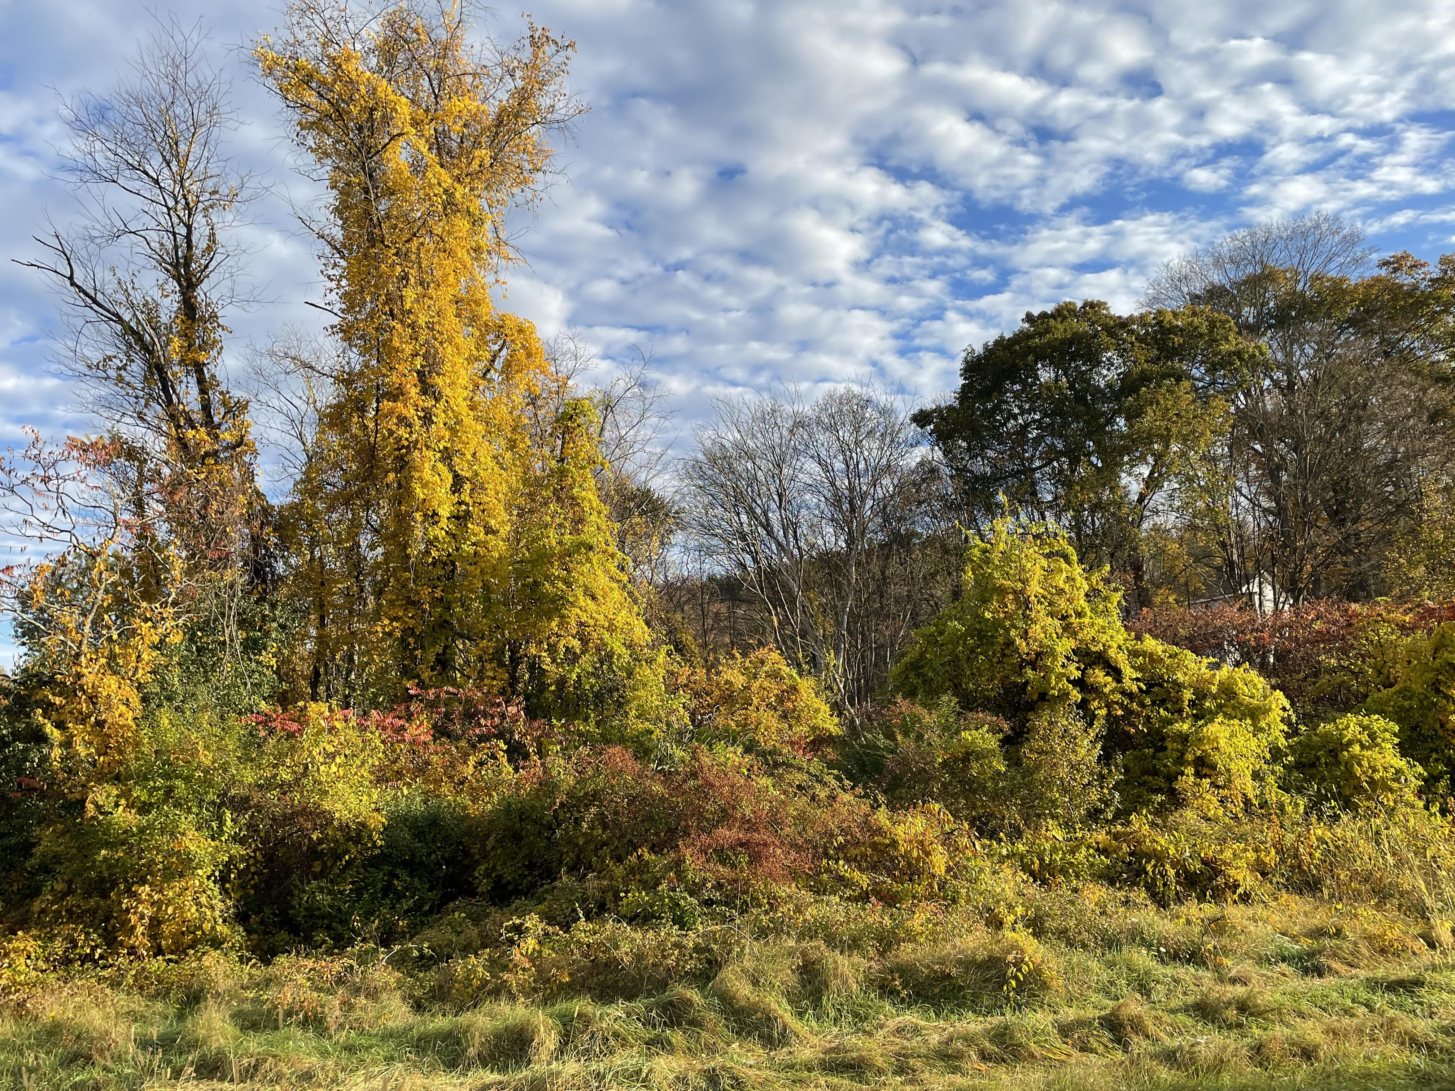
Why do we care?
Landscape-functional resilience
Increasing relevance to conservation

Slide 6
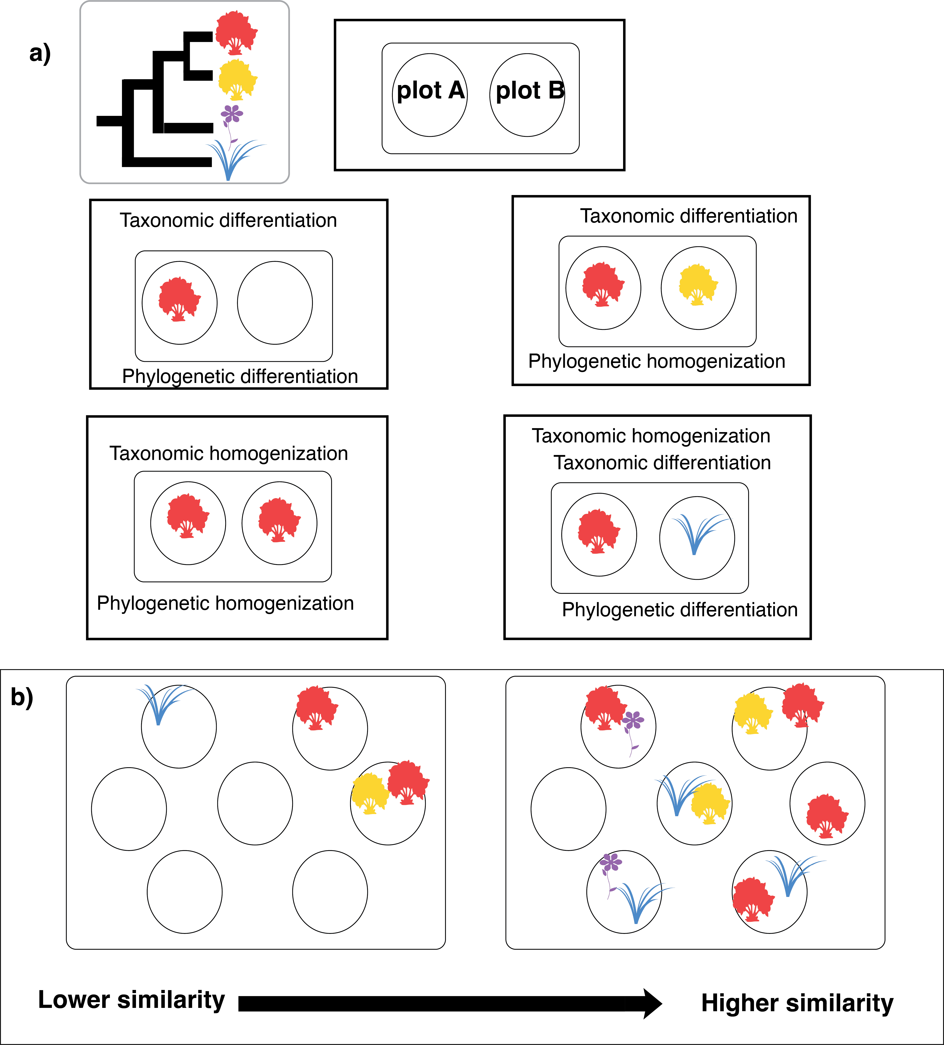
Further, BH might vary among regions, facets of biodiversity and methods (abn vs. occ data)

Slide 7
Since we are interested in BH on a landscape/region scale here is how we formulate the hypothesis
Invaded plots are more compositionally similar to each other than uninvaded plots
regions with more invasive spread (% of plots invaded: can I call that an invasion rate?) have more a homogeneous flora than ecologically similar regions with less invasion.

Slide 8
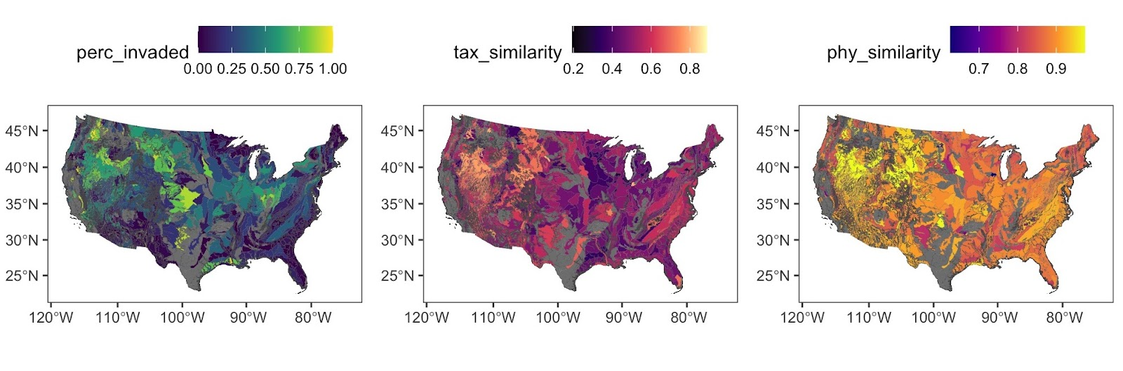
Hill numbers to calculate taxonomic and phylogenetic beta diversity for US L4 ecoregions and regress them against % of each plots in L4 ecoregions with >5% non-native cover. Use sampling effort (total plots/region as covariate)

Slide 9
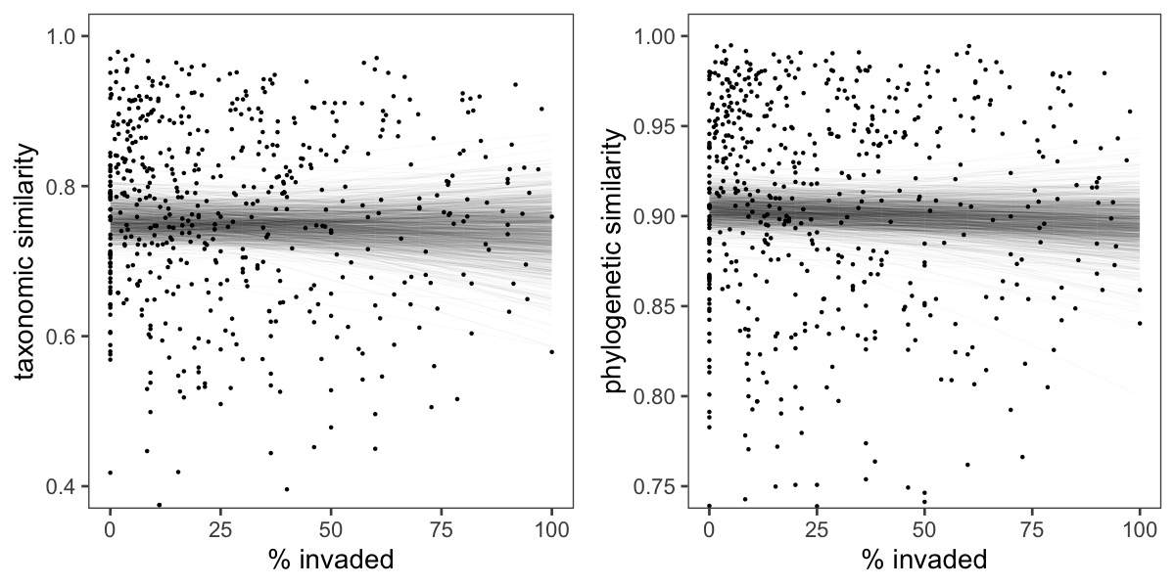
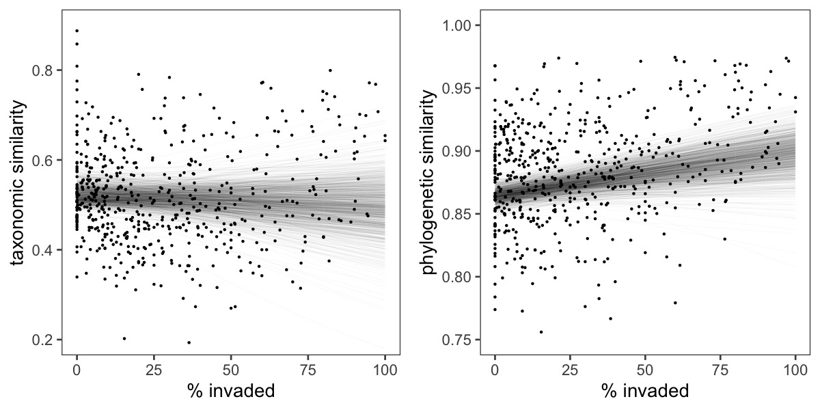
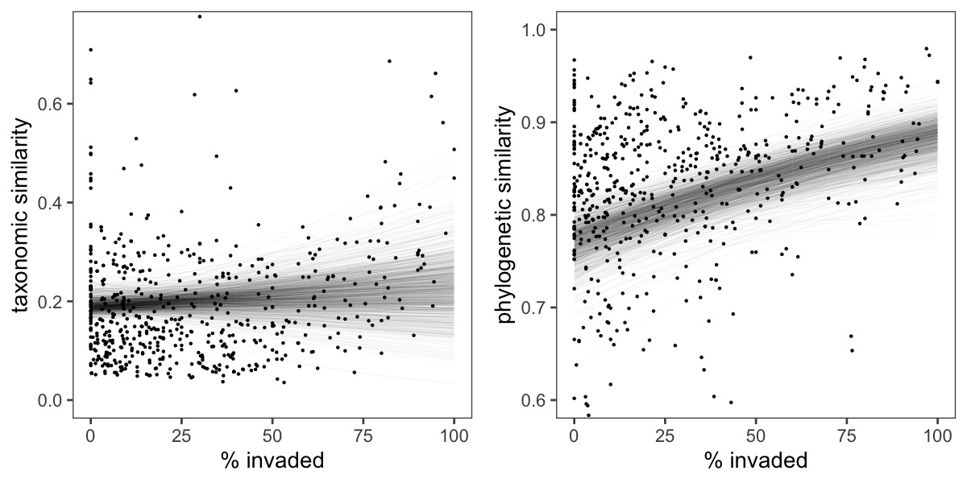
Occurrence based
Abundance weighted
Abundance double weighted
Notes:
Show all of these or put 2 in supp?

Slide 10
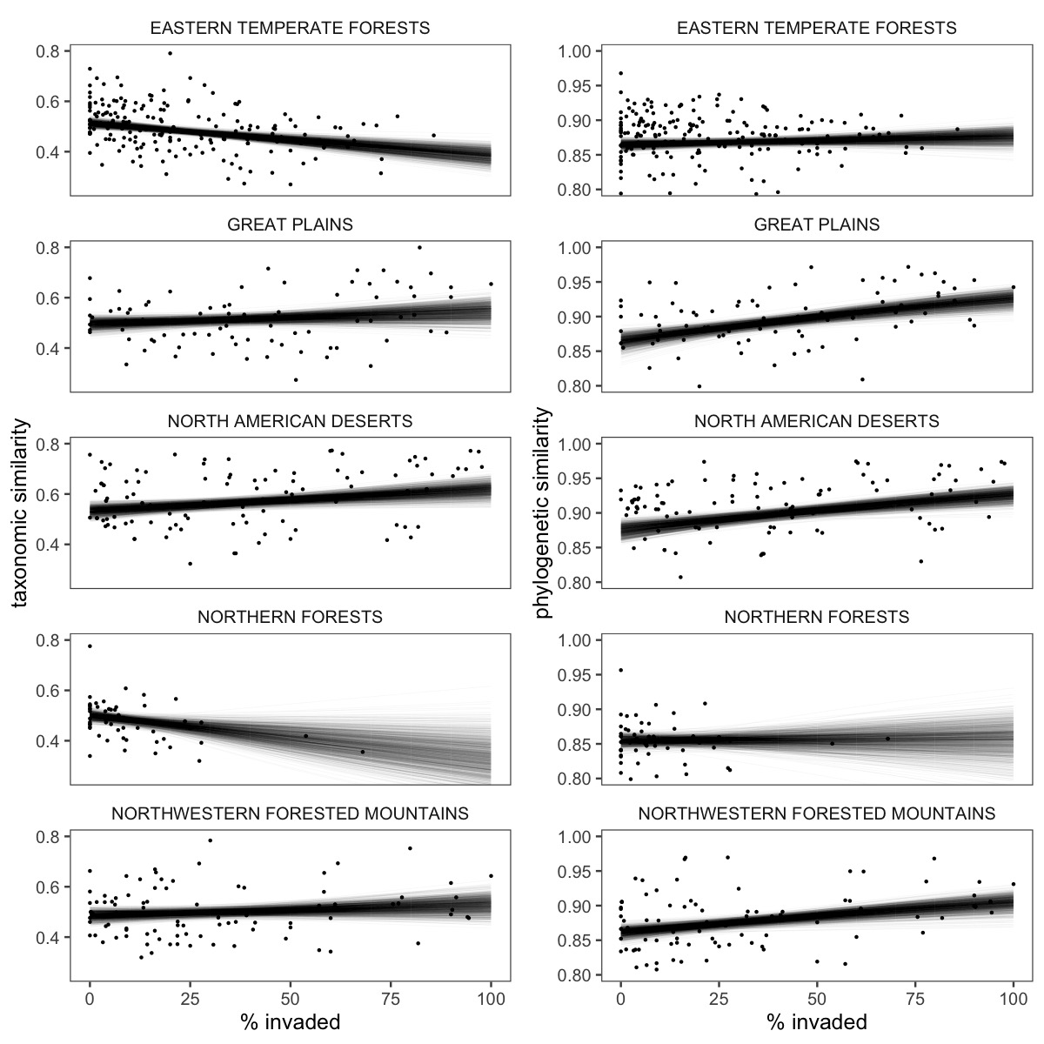
Abundance weighted

Slide 11
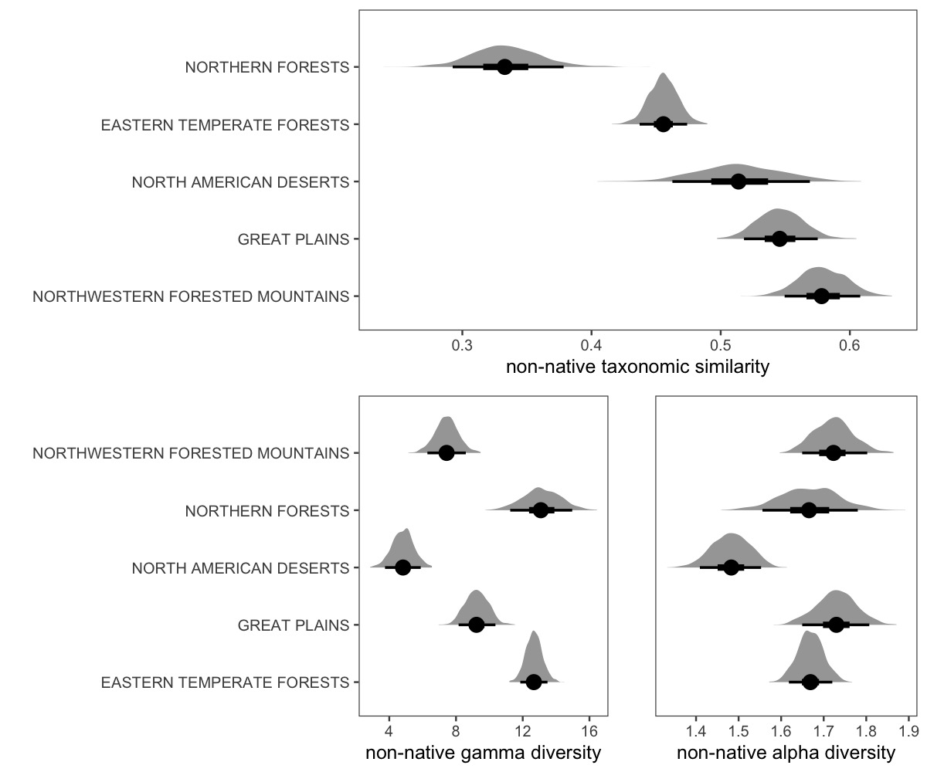
Non-native taxonomic diversity

Slide 12
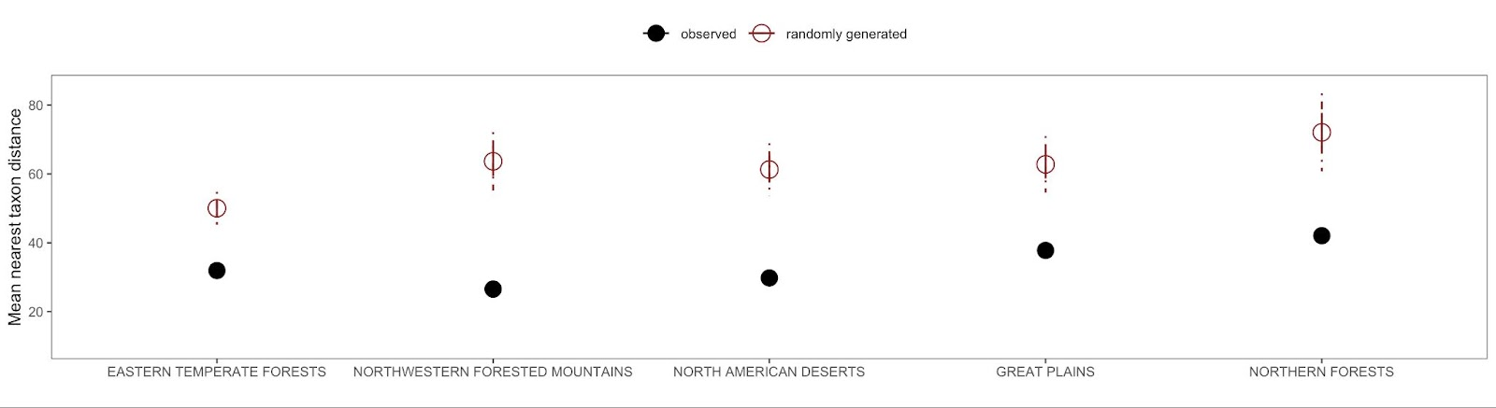
Non-native phylogenetic structure

Slide 14
Place holder: Also re-ran analysis with just the native species of each region. Relationships were weaker but similar trends, suggesting changes in beta diversity are a product of both the presence of invaders themselves, and difference in native beta diversity at higher invasion rates

Slide 15
Points for Discussion
Restate finds and cite papers that support
Reiterate why phylogenetic trends toward homogenization…cite many papers that find phylogenetics structure in invasive flora
Speculate on other aspects of ecology that could drive different trends in taxonomic H between forests and other regions. i.e., growth forms.
Link to management?
Highlight the importance of abundance data. Especially that it links better to function

Slide 16
ABfT
Invasive species are a major threat to biodiversity. One of the ways we expect them to do this is through biotic homogenization (define). BUT Homogenization is not the only outcome of widespread invasion… invasive species can also drive the opposite---biotic differentiation. FURTHER, the direction and magnitude of these trends in biodiversity can, vary among regions, facets of beta diversity (ie taxonomic, or phylogenetic) and sampling methods (ie occurrence vs. abudance data), which can have different implications for different ecological management goals (ie landscape function vs. species conservation) THEREFORE it is important to quantify this broadl

Slide 17
ABfT
One of most widely predicted/reported/theorized effects of biological invasions on biodiversity is biotic homogenization. Biotic homogenization hypothesis predicted regions with widespread invasive species should be more homogeneous than those with lower invasion rates. BUT Homogenization is not the only outcome of widespread invasion… invasive species can also drive the opposite---biotic differentiation. FURTHER, the direction and magnitude of these trends in biodiversity can vary among facets of beta diversity (ie taxonomic, or phylogenetic) and sampling methods (ie occurrence vs. abundance data). while BH research has increased considerably lately, we are aware of no/few studies that tested this regional level predictions, but that is what really matters to connect land scape ecosystem function to BH which is the major concern THEREFORE We did it.

